Slide 1
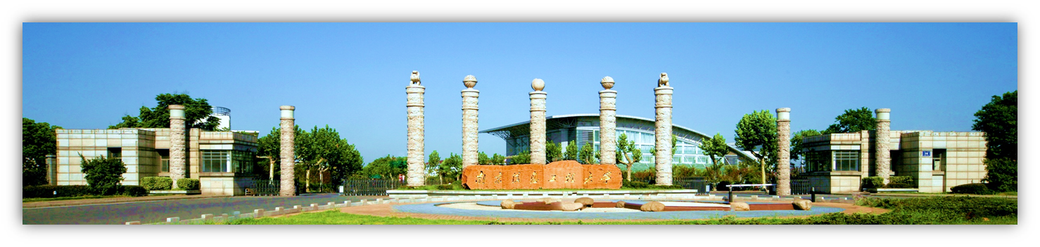
Chapter 4 Continuous-Wave Modulation (连续波调制)
Linear modulation: 线性调制
Amplitude modulation (AM) 调幅
Double-sideband modulation (DSB) 双边带调制
Single-sideband modulation (SSB) 单边带调制
Vestigital-sideband modulation(VSB)

Slide 2
SSB modulation system
System model: ①Filtering method滤波法
②phase-shift method相移法
Time & frequency-domain characteristics
时域频域特性
Anti-noise performance 抗噪声性能
Practical SSB system 实际 SSB系统
Special Topic: FDM 频分复用

Slide 3
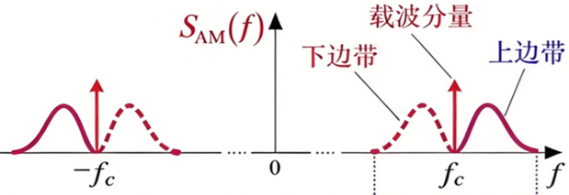
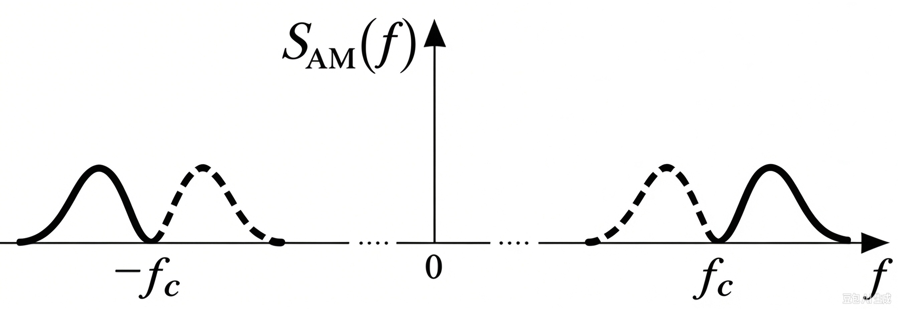
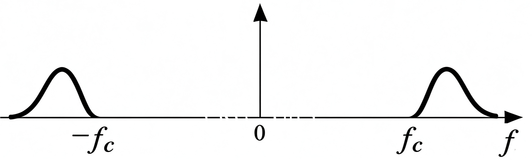
Carrier+
double side band
Improve power efficiency
SDSB(f)
Double side band
Improve bandwidth efficiency
SsSB(f)
Single side band

Slide 4
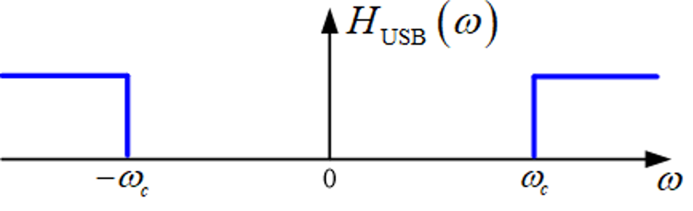
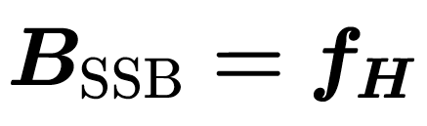
m(t)
sDSB(t)
×
cosωct
Modulation
SSB
➕

Slide 5
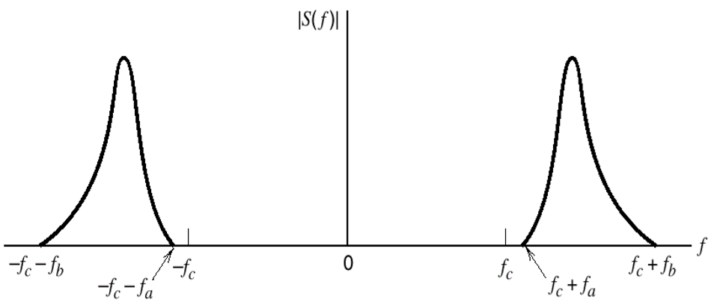
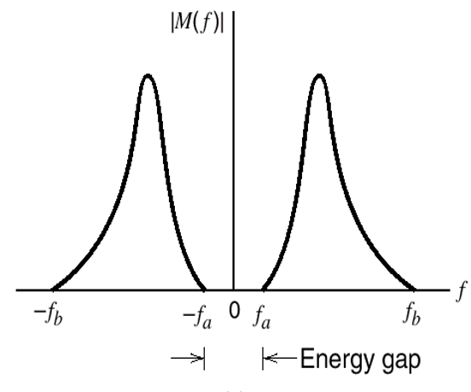
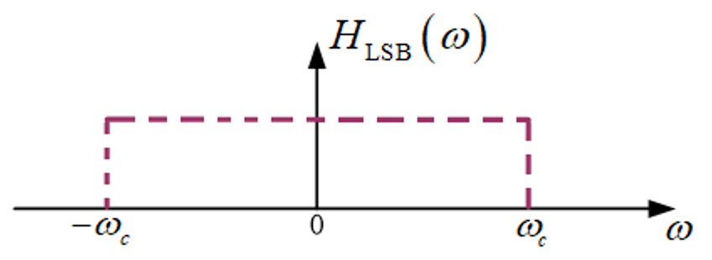
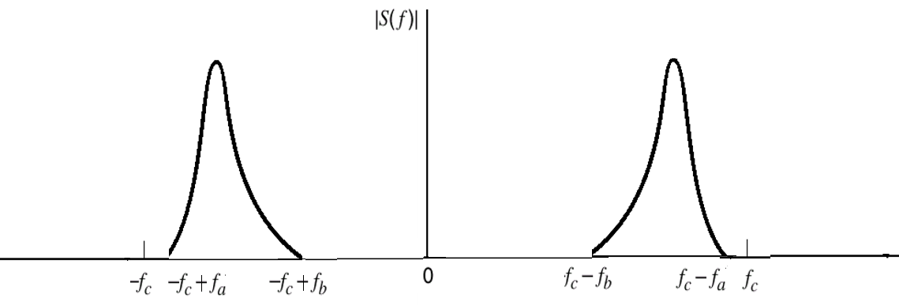
SSB System model——① filter method
sDsB(t)
sssB(t)
m(t)
BPF
带通滤波
LPF
低通滤波
~
×
H(ω)
Channel
×
m(t)
c
a
b
cosωct
carrier
cosωct
n(t)
加性噪声
The filtering method requires the baseband signal to have a spectral gap near zero frequency.
b
c
Upper side band
a
Lower side band

Slide 6
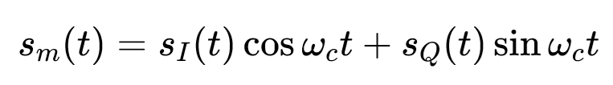
Special Topic: I/Q Paths
I支路
~
HI(ω)
sI(t)
LPF
SI(t)
×
×
cosωct
cosωct
m(t)
sm(t)
Phase-shifter
-90°
Phase-shifter
+
sinωct
sinωct
sQ(t)
~
LPF
SQ(t)
HQ(ω)
×
×
Q支路
Fig. General model of linear modulation (phase-shift method).
备注：

Slide 7
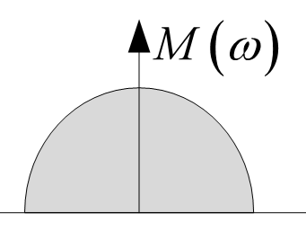
SSB System model——I/Q 支路
I支路
~
m(t)
SI(t)
×
×
LPF
cosωct
cosωct
sssB(t)
Hh(ω)
Phase-shifter
-90°
Phase-shifter
sinωct
sinωct
~
m(t)
LPF
SQ(t)
×
×
Q支路
Hilbert transformer Hh(ω): introduces a -90° phase shift for m(t).
Phasing (I/Q): Cancels sidebands by phase superposition without filtering. Hilbert transform & quadrature carriers, no baseband zero-frequency spectral gap needed.
相移法 (I/Q)：通过相位叠加抵消边带，无需滤波。采用希尔伯特变换与正交载波，不需要基带零频谱间隙。
No gap

Slide 8
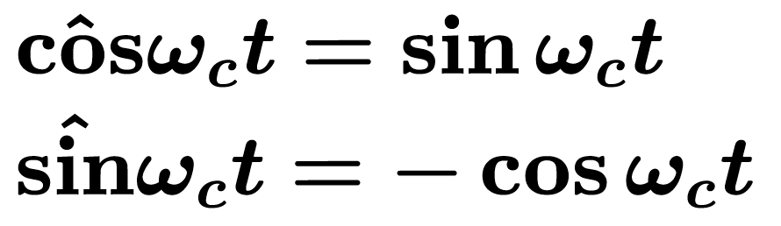
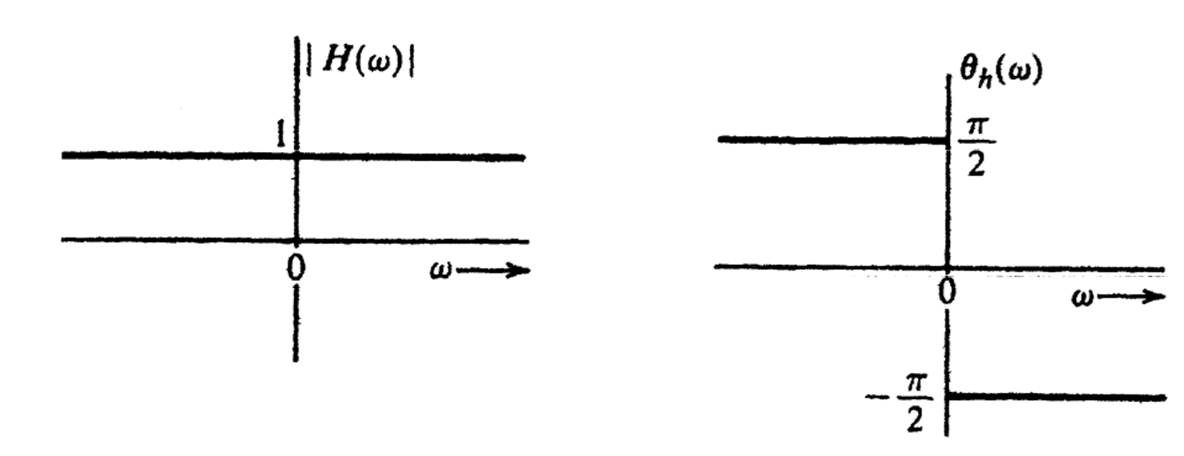
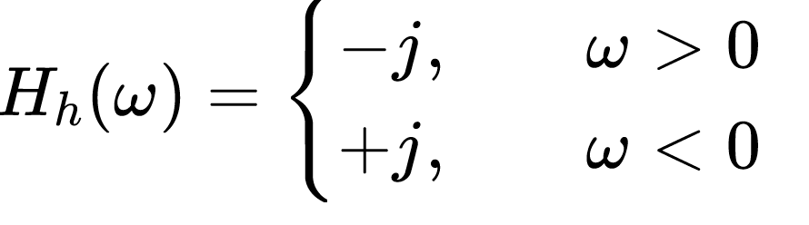
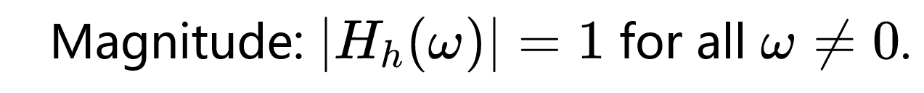
SSB System model——I/Q 支路
I支路
~
m(t)
SI(t)
×
×
LPF
cosωct
cosωct
sssB(t)
Hh(ω)
Phase-shifter
-90°
Phase-shifter
sinωct
sinωct
~
m(t)
LPF
SQ(t)
×
×
Q支路
Hilbert transformer Hh(ω):
introduces a -90° phase shift for m(t).

Slide 9
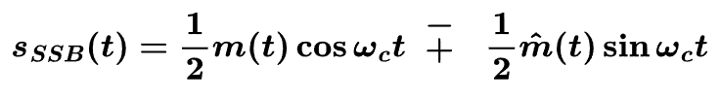


SSB System model——I/Q 支路
I支路
m(t)
×
cosωct
sm(t)
Hh(ω)
Phase-shifter
➖
Upper side band
sinωct
×
m(t)
Q支路
Upper side band:
Lower side band:

Slide 10
System model——I/Q 支路
I支路
m(t)
×
cosωct
sm(t)
Hh(ω)
Phase-shifter
➕
➕: Lower side band
sinωct
×
m(t)
Q支路
Upper side band:
Lower side band:

Slide 11

SSB System model——I/Q 支路 保留上边带
I支路
~
m(t)
SI(t)
×
×
LPF
cosωct
cosωct
sm(t)
Hh(ω)
Phase-shifter
-90°
Phase-shifter
➖
sinωct
sinωct
~
Q支路
LPF
SQ(t)
×
×
m(t)
In theory, only the I branch is required for demodulation, and the Q branch contains no valid information. The full I/Q architecture is retained in hardware for standardized implementation.
理论上解调仅需恢复 I 支路，Q 支路无有效信息

Slide 12
SSB System model——I/Q 支路
m(t)
×
简
化
版
cosωct
sm(t)
~
LPF
SI(t)
×
sinωct
cosωct
Demodulator
Hh(ω)
×
In theory, only the I branch is required for demodulation, and the Q branch contains no valid information.
理论上解调仅需恢复 I 支路，Q 支路无有效信息。

Slide 13
SSB modulation system
System model: abstraction
系统模型：抽象
Time & frequency-domain characteristics
时域频域特性
Anti-noise performance 抗噪声性能
Practical SSB system 实际 SSB系统
Special Topic: FDM 频分复用

Slide 14
Table 1 Time & Frequency Domain Comparison
Signal | Time-domain 时域 | Frequency-domain 频域
SSSB
Waveformor spectrum | (绘制 SSB 时域波形) | （绘制 SSB 频谱）

Slide 15
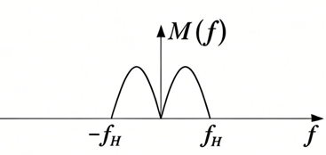
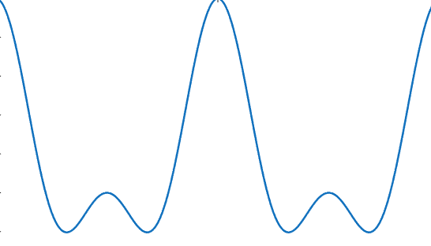
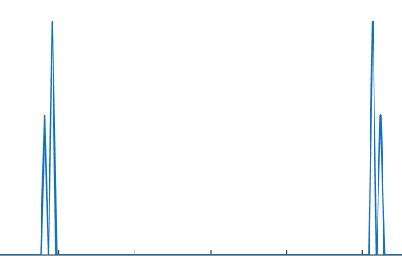
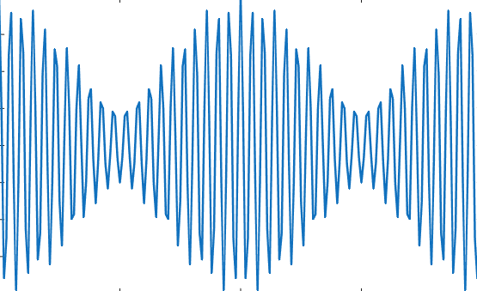
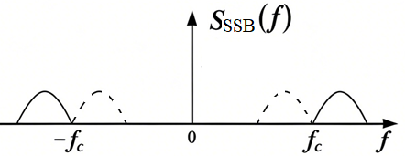
SSB modulation system

Slide 16
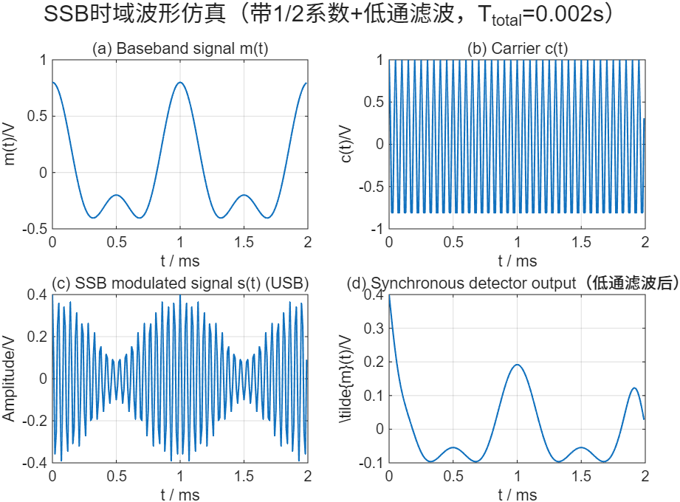
SSB

Slide 17
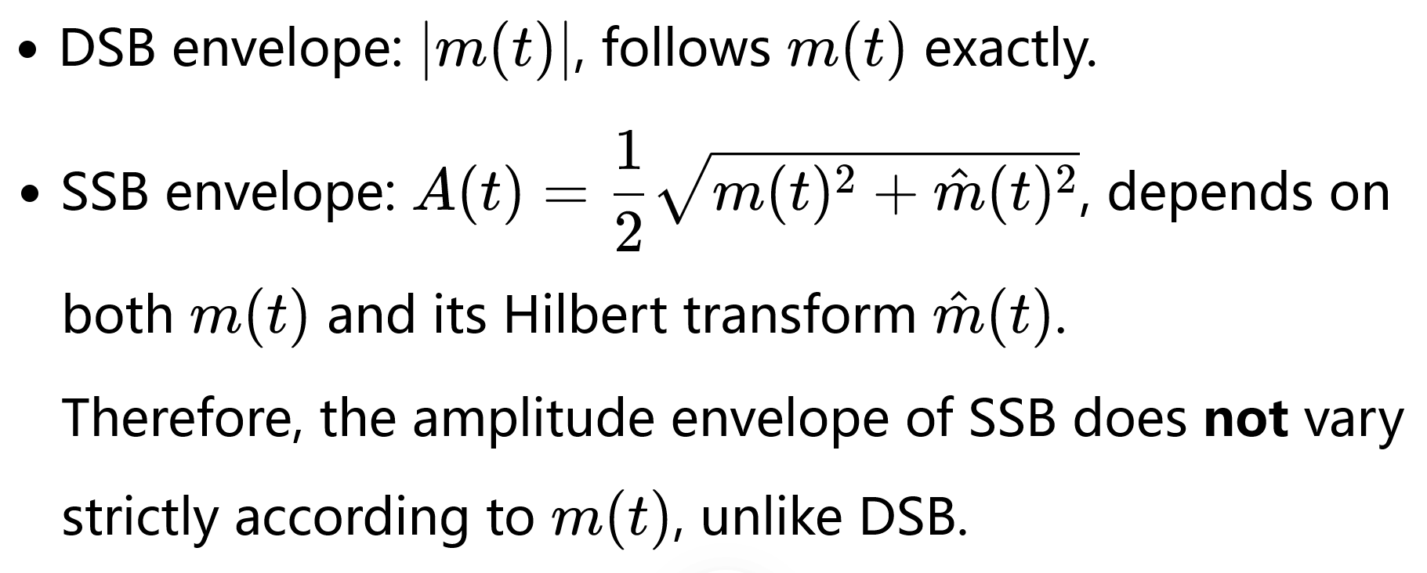
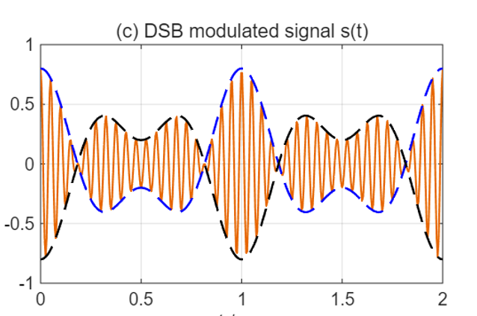
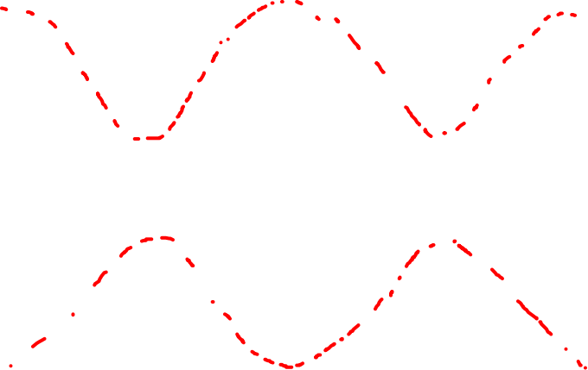
SSB

Slide 18
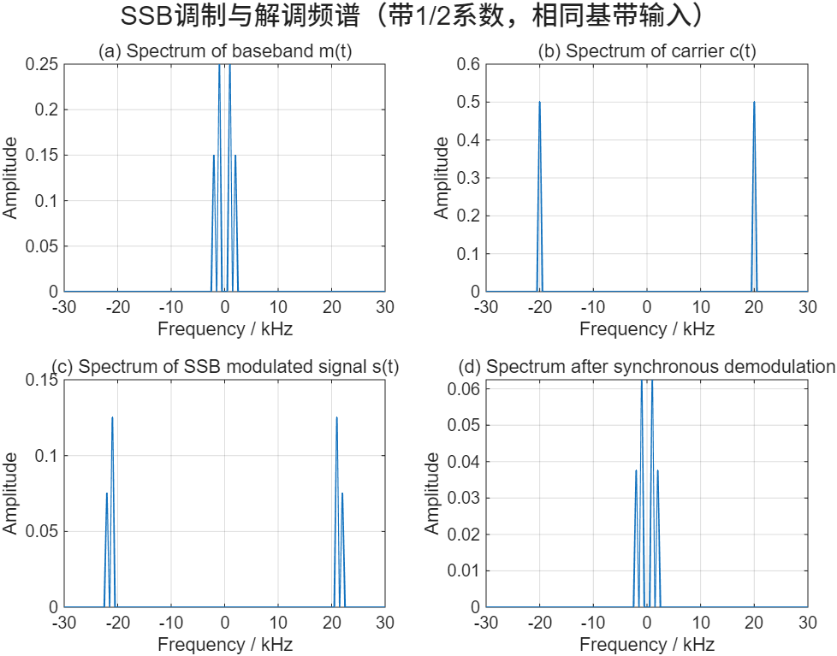


SSB communication simulation
0.25
$≈$0.06
$≈$0.125
衰减1/4
衰减1/2
Upper Side Band

Slide 19
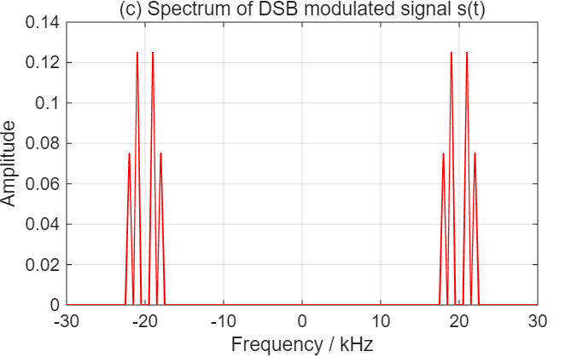
SSB communication simulation
Upper Side Band
DSB

Slide 20
Time & frequency-domain characteristics
I支路
m(t)
a
×
cosωct
Phase-shifter
sm(t)
~
Hh(ω)
LPF
SI(t)
➖
×
b
c
d
sinωct
cosωct
m(t)
×
Q支路
b

Slide 21
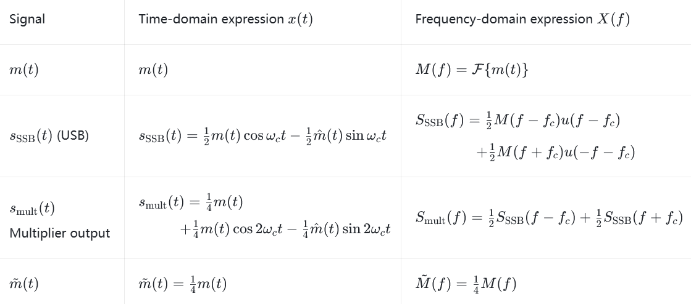
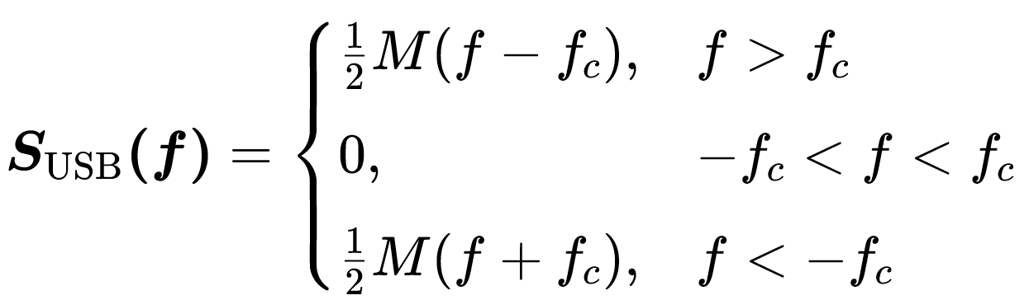
Time & frequency-domain characteristics——上边带
a
b
c
d

Slide 22
SSB modulation system
System model: abstraction
系统模型：抽象
Time & frequency-domain characteristics
时域频域特性
Anti-noise performance 抗噪声性能
Practical SSB system 实际 SSB系统
Special Topic: FDM 频分复用

Slide 23
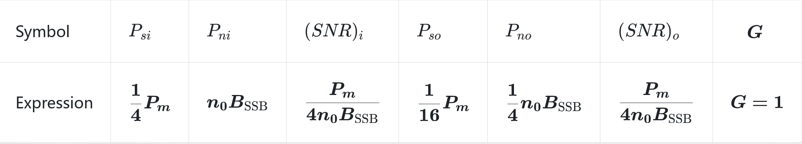
Anti-noise performance 抗噪声性能——SSB
m(t)
×
I支路
sm(t)
cosωct
~
LPF
SI(t)
➖
×
sinωct
Q支路
cosωct
Hh(ω)
×
Demodulator
m(t)
G

Slide 24
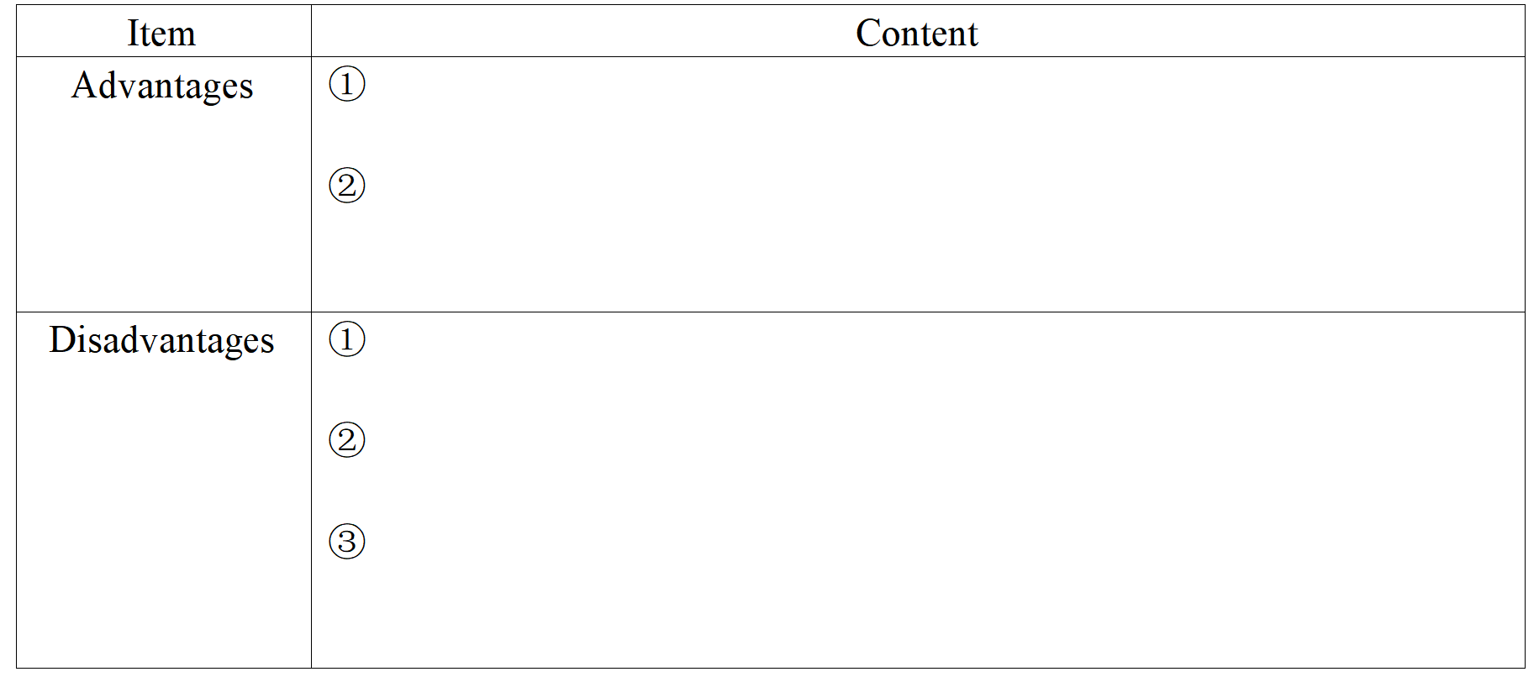
Discussion & Summary——SSB system

Slide 25
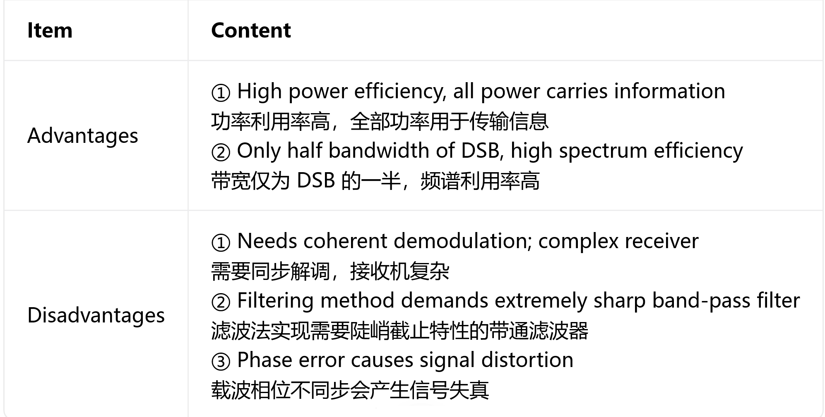
Discussion & Summary——SSB system

Slide 26
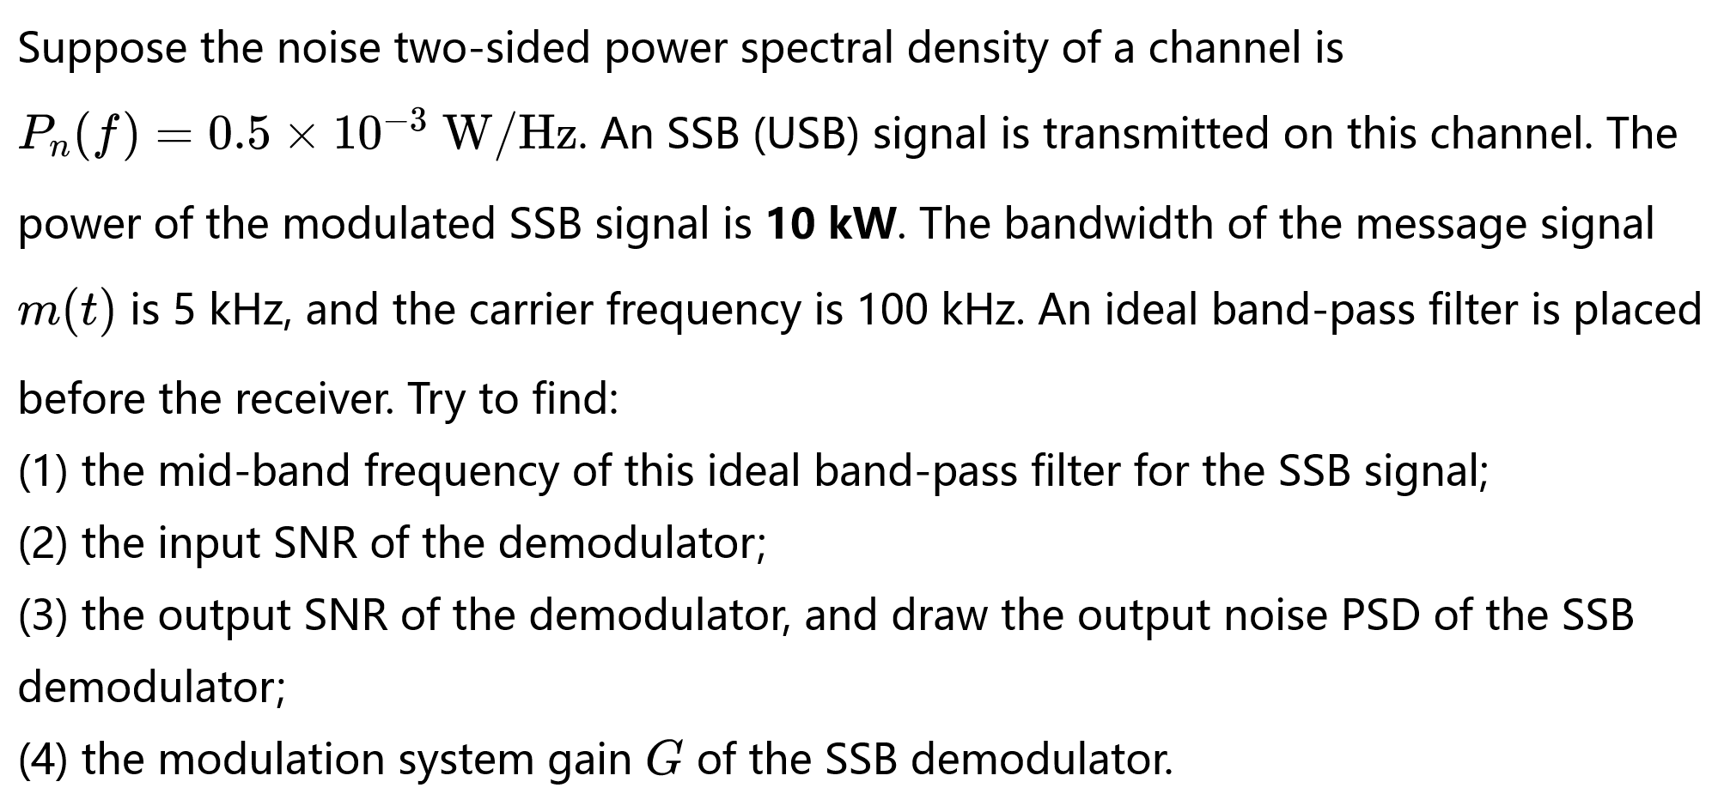
Example 3

Slide 28
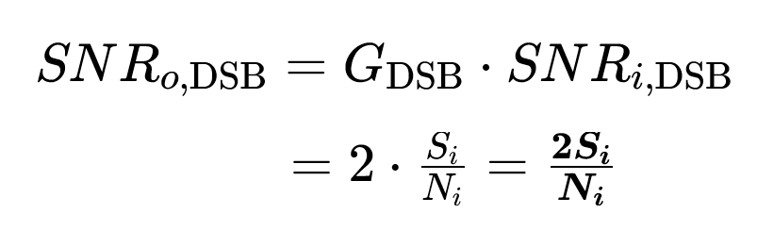
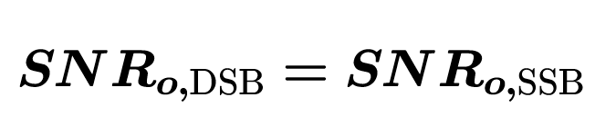
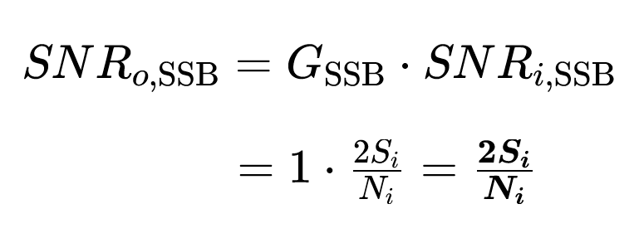
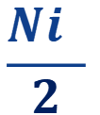


Anti-noise performance DSB vs SSB——dicussion
Si
×
LPF
低通滤波
$$Ni$$
cosωct
Same
Si
no
fH
Demodulator
DSB-SC 相干解调系统抗噪声性能分析框图
$$\text{S}\text{i}$$
~
LPF
SI(t)
×
$$\frac{Ni }{2}$$
cosωct
Demodulator
SSB相干解调系统抗噪声性能分析框图
Conclusion： Under the conditions of the same transmitted signal power Si, the same noise power spectral density no and the same baseband bandwidth fH, DSB and SSB have equal output SNR.

Slide 29
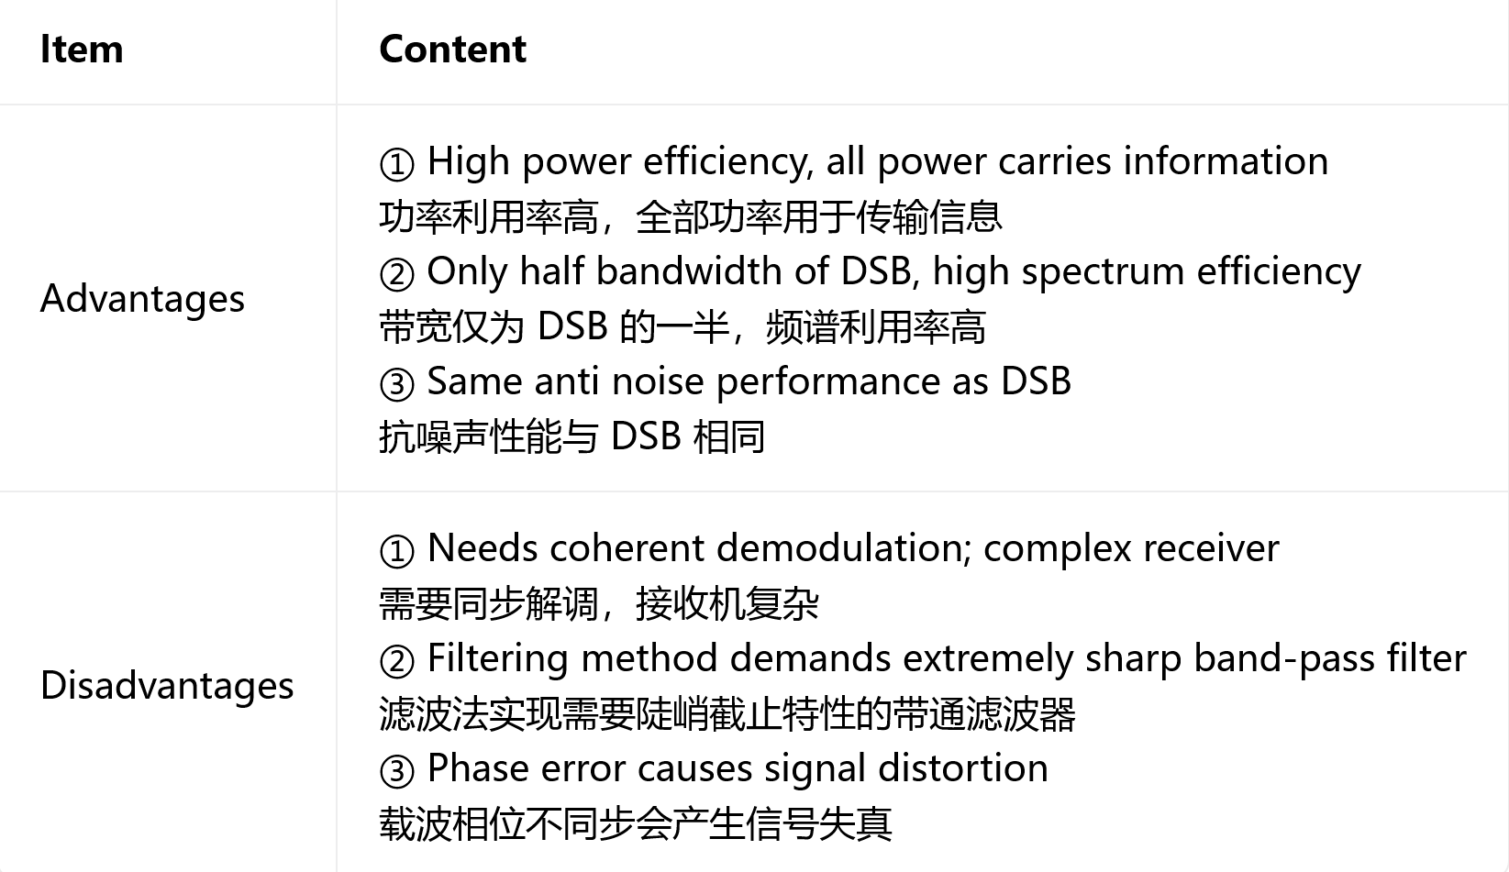
Discussion & Summary——SSB system

Slide 30
SSB modulation system
System model: abstraction
系统模型：抽象
Time & frequency-domain characteristics
时域频域特性
Anti-noise performance 抗噪声性能
Practical SSB system 实际 SSB系统
Special Topic: FDM 频分复用

Slide 31
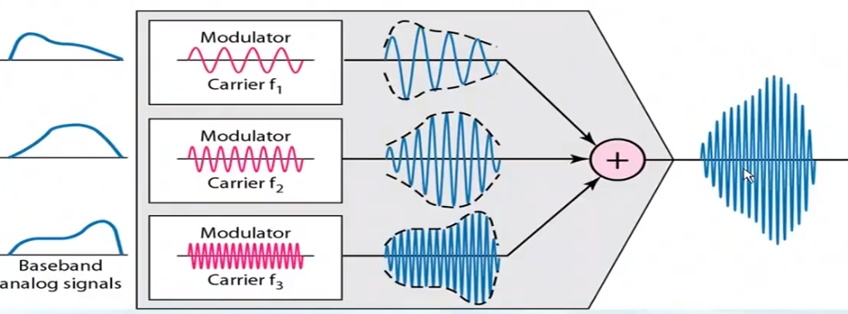
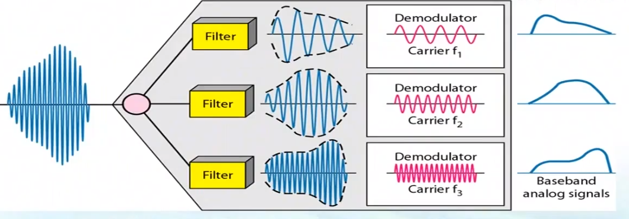
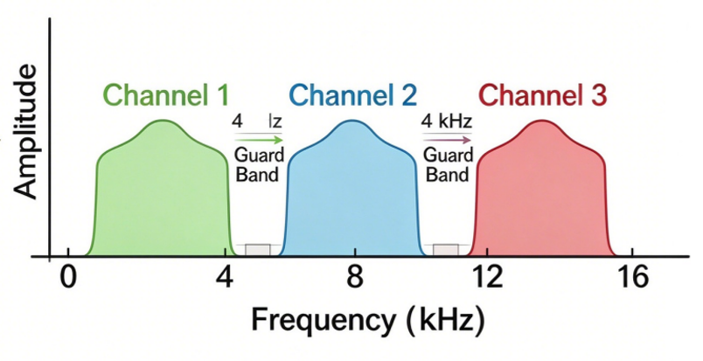
FDM: Frequency-Division Multiplexing
FDM shifts multiple baseband signals to different non-overlapping不重叠 frequency bands and transmits them simultaneously同时 over one shared channel.

Slide 32

FDM: Frequency-Division Multiplexing

Slide 33
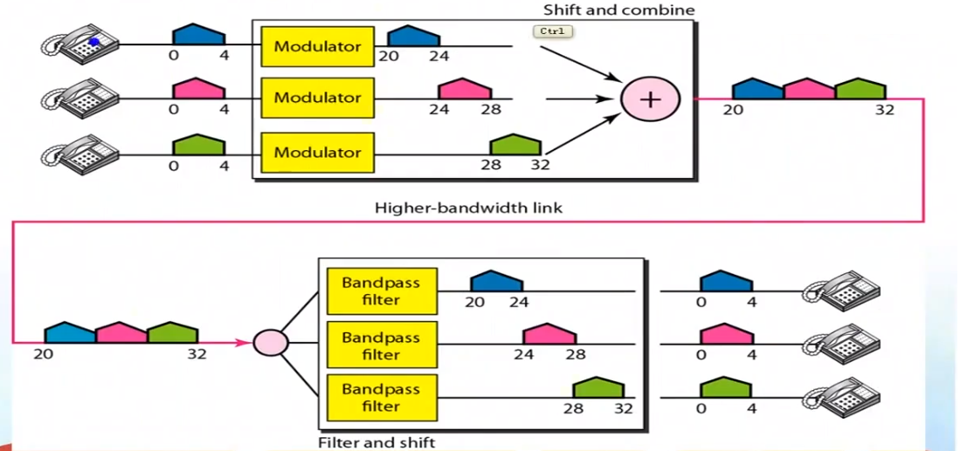
FDM: Frequency-Division Multiplexing
Each channel uses
SSB modulation.
Multicarrier telephone system
FDM shifts multiple baseband signals to different non-overlapping frequency bands and transmits them simultaneously over one shared channel.

Slide 34
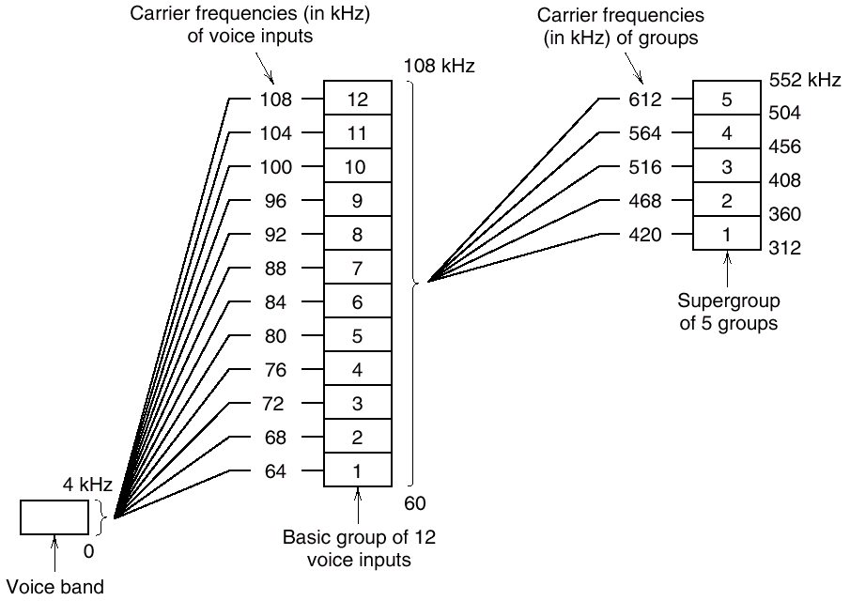
FDM: Frequency-Division Multiplexing
multi-stage modulation 多级调制
multi-stage multiplexing 多级复用
12 channels ⤳ one basic group 基群
5 basic groups ⤳ one supergroup (60 channels)
超群
10 supergroups ⤳ one mastergroup (600 channels)
主群
Figure I llustrating the modulation steps in an FDM system
——Multicarrier telephone system
.
Multi-stage modulation simplifies band-pass filter design for separating adjacent channels. It avoids extremely high carrier frequencies in single-step modulation.

Slide 35
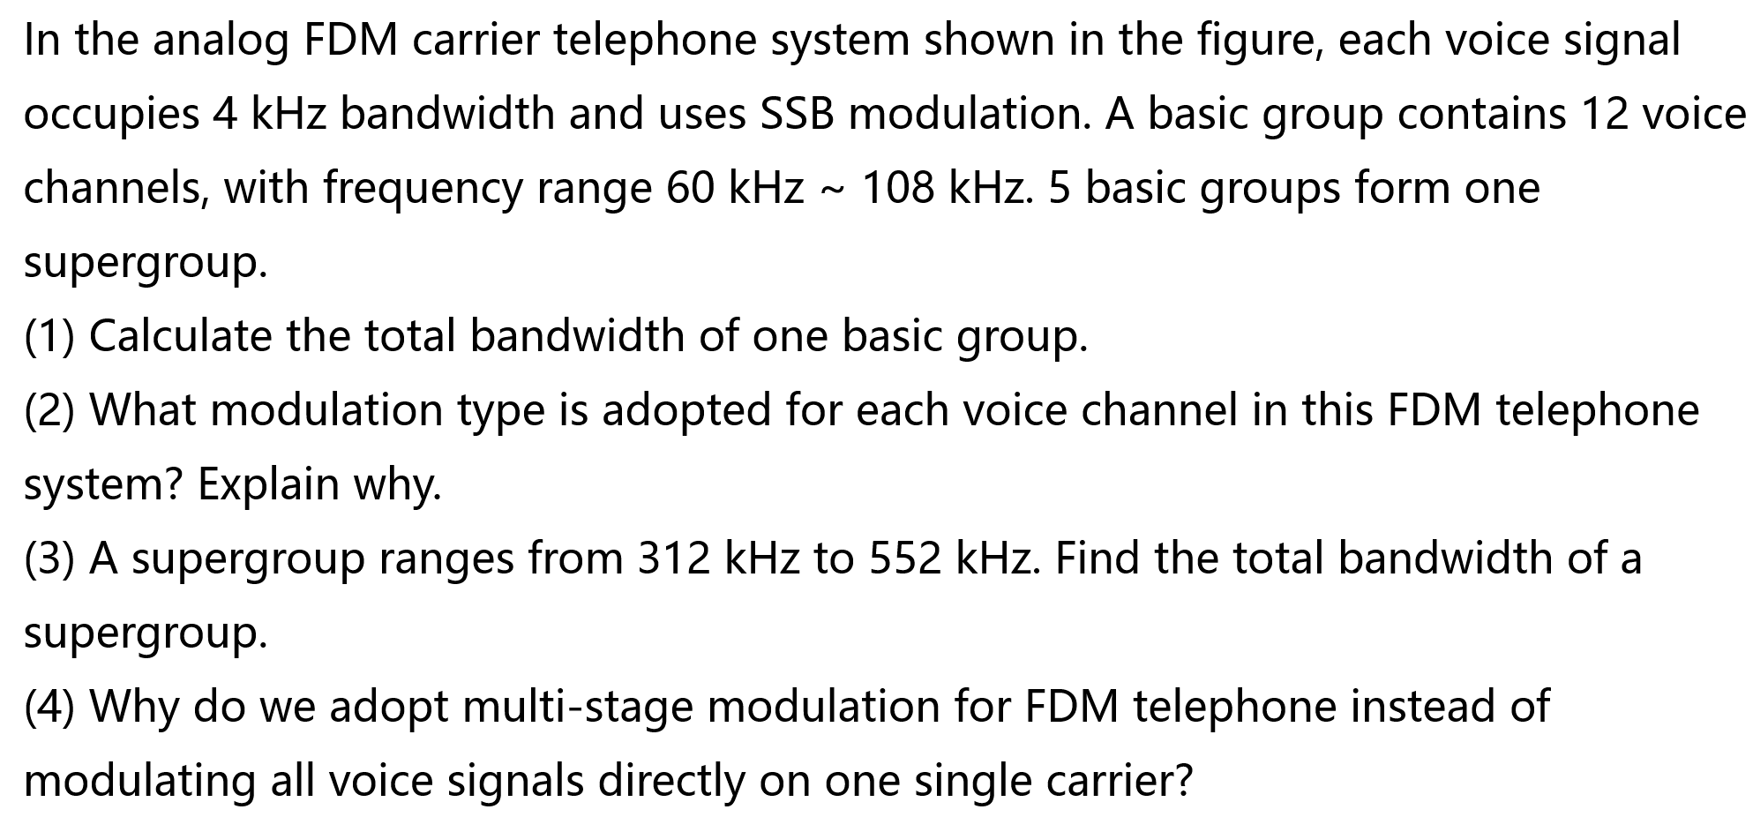
Problem

Slide 37
Part II VSB
Linear modulation: 线性调制
Amplitude modulation (AM) 调幅
Double-sideband modulation (DSB) 双边带调制
Single-sideband modulation (SSB) 单边带调制
Vestigital-sideband modulation(VSB)
--VSB bandwidth is slightly larger than SSB but much smaller than DSB. Its anti noise performance is close to SSB, and no sharp filter transition band is needed for easier implementation.
滤波器过渡带不用像 SSB 那么陡峭，工程更容易实现。

Slide 38
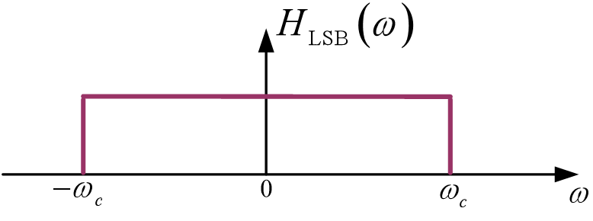
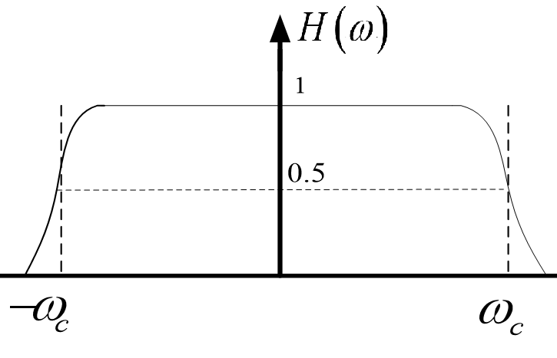
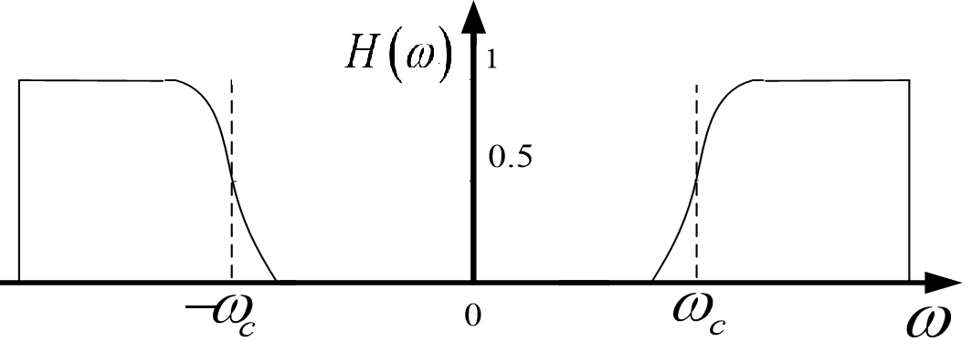
VSB System model—— filter method
sssB(t)
sVSB(t)
m(t)
BPF
带通滤波
LPF
低通滤波
~
×
H(ω)
Channel
×
m(t)
c
a
b
cosωct
cosωct
n(t)
Ideal 不可实现
or
Practical 可实现
or

Slide 39
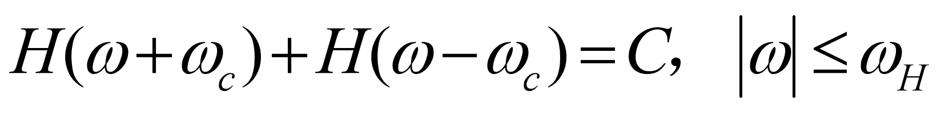
System model——filter method
sVSB(t)
sssB(t)
m(t)
BPF
带通滤波
LPF
低通滤波
~
×
c
Channel
×
m(t)
c
a
b
cosωct
carrier
cosωct
n(t)
加性噪声
Prove that the transfer function H(ω) of the VSB filter satisfies:
Practical 可实现
or

Slide 41


Slide 42


